Slide 1
Probability and Statistical Inference
Correlation and Difference
Sources used in creation of this lecture:
Statistics and Data Analysis, Peck, Olsen and Devore; Discovering Statistics Using IBM SPSS (And equivalent R book), Andy Field; Understanding Basic Statistics, Brase and Brase;SPSS Survival Manual, Julie Pallant

Slide 2
Before Inferential Statistics…
We need to establish evidence to support going ahead with building a predictive model
If we are asserting a relationship
We need to investigate if there is any evidence of a relationship using the appropriate test and make a decision based on the results (strength, direction etc.)
If we are asserting a differential effect for different groups
We need to investigate if there is any difference using the appropriate test and make a decision based on the result

Slide 3
The General Linear Statistical Model
Concepts of interest (measured by their variables) are hypothesised to be related to each other in some way
The goal is to summarize or describe accurately what is happening in the data.
Easiest way to think about it is for bivariate data
Looking to model the pattern in ordered pairs where each member of the pair is the value of one of the variables of interest
Our statistical model takes the form of a mathematical equation
Outcome_{i} = model + error_{i (}i = ith case)
Outcome in the data we observed = model we built + an error
In the linear model
Trying to fit a line to it to model the pattern
Using the equation of a line y = b₀ + b₁x + e
Where y is our dependent (or outcome) variable and x is the independent (or predictor)
b₀ is the intercept (value of y when x is 0)
e is the error term - the degree to which the line is in error in describing each data point

Slide 4
Correlation - what are we interested in?
Direction
Positive or negative
Slope of the line
Strength
How close are the data points to the line
Very close = strong
Very dispersed = weak

Slide 5
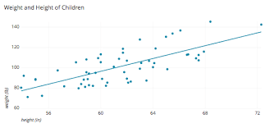
Scatterplots
When to Use
Bivariate numerical data (two variables)
Plot the relationship between two variables
One independent, one dependent
Collection of ordered pairs
How to construct
Draw a horizontal scale and mark it with appropriate values of the independent variable
Draw a vertical scale and mark it appropriate values of the dependent variable
Plot each point corresponding to the observations
To describe
Comment the relationship between the variables

Slide 6
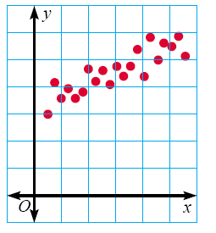
Positive Correlation
If the x-coordinates and the y-coordinates both increase, then it is POSITIVE CORRELATION.
This means that both are going up, and they are related.

Slide 7
Positive Correlation
If you look at the age of a child and the child’s height, you will find that as the child gets older, the child gets taller.
Because both are going up, it is positive correlation.
Age | 1 | 2 | 3 | 4 | 5 | 6 | 7 | 8
Height | 25 | 31 | 34 | 36 | 40 | 41 | 47 | 55

Slide 8
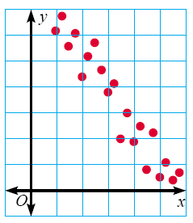
Negative Correlation
If the x-coordinates and the y-coordinates have one increasing and one decreasing, then it is NEGATIVE CORRELATION.
This means that 1 is going up and 1 is going down, making a downhill graph.
This means the two are related as opposites.

Slide 9
Negative Correlation
If you look at the age of a car and its value, you will find as the car gets older, the car is worth less.
This is negative correlation.
Age of car | 1 | 2 | 3 | 4 | 5
Value | €30,000 | €27,000 | €23,500 | €18,700 | €15,350

Slide 10
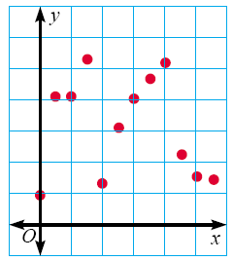
No Correlation
If there seems to be no pattern, and the points looked scattered, then it is no correlation.
This means the two are not related.

Slide 11
No Correlation
If you look at hair colour of boots a premier league footballer wears and their scoring average, you will find that there is no correlation between the two.

Slide 12
Scatterplots
Which scatterplots below show a linear trend?
a)
c)
Negative
Correlation
e)
Positive
Correlation
b)
d)
f)
Constant
Correlation

Slide 13
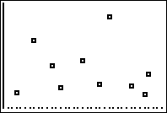
Suppose we found the age and weight for each person in a sample of 10 adults. Is there any relationship between the age and weight of these adults?
Create a scatterplot of the data below.
There does not appear to be a relationship between age and weight in adults.
Do you think there is a relationship? If so, what kind? If not, why not?
Weight
Age
Age | 24 | 30 | 41 | 28 | 50 | 46 | 49 | 35 | 20 | 39
Wt | 256 | 124 | 320 | 185 | 158 | 129 | 103 | 196 | 110 | 130
Notes:
Students should doubt that any relationship exists between age and weight.
Ask students what feature of the scatterplot indicates that there is little to no relationship between age and weight in adults.

Slide 14
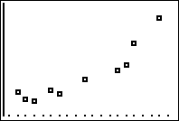
Suppose we found the height and weight for each person in a sample of 10 adults. Is there any relationship between the height and weight of these adults?
Create a scatterplot of the data below.
Weight
Do you think there is a relationship? If so, what kind? If not, why not?
Height
Is it positive or negative? Weak or strong?
Ht | 74 | 65 | 77 | 72 | 68 | 60 | 62 | 73 | 61 | 64
Wt | 256 | 124 | 320 | 185 | 158 | 129 | 103 | 196 | 110 | 130
Notes:
Have students explain what features of the graph indicate that there is a relationship between height and weight in adults.

Slide 15
Correlation
The relationship between bivariate numerical variables
May be positive or negative
May be weak or strong
What feature(s) of the graph would indicate a weak or strong relationship?
What does it mean if the relationship is positive?
negative?
Notes:
A positive relationship is one where as x increases, y increases.
A negative relationship is one where as x increases, y dereases.

Slide 16
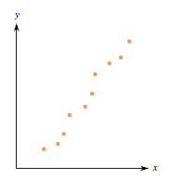
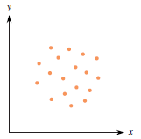
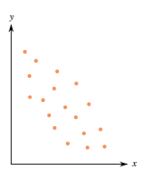
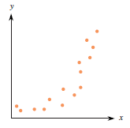
Identify the strength and direction of the following data sets.
Set A
Set B
Set C
Set D
Set D shows a strong, positive curved relationship.
Set A shows a strong, positive linear relationship.
Set B shows little or no relationship.
Set C shows a weaker (moderate), negative linear relationship.
Notes:
Direction should be positive or negative (or none)
Strength should be weak or strong
Be sure to ask what feature(s) of the graph indicate the relationship.
Set A has a strong, positive linear relationship.
Set B shows little or no relationship.
Set C has a moderate, negative linear relationship.
Set D has a strong positive curved relationship.

Slide 17
Simple Example
Suppose we want to look at children’s maths scores at age 16 and their achievement of a standard maths test at aged 7
We are interested to see if the score a child achieves at age 7 is related to the score they achieve at age 16
And if so what is the direction and strength of the relationship

Slide 18
Simple Example
y = b0 + bx + e
‘y’ is the outcome variable (in this case GCSE Score) – the dependent variable
‘
y
b0
x
Relationship between Maths score age 7 with GCSE result at age 16 (for 25 students)

Slide 19
Simple Example
y = b0 + bx + e
‘x’ is the independent variable (in this case Maths Score aged 7)
y
b0
x
Relationship between Maths score age 7 with GCSE result at age 16 (for 25 students)

Slide 20
Simple Example
y = b0 + bx + e
‘b0’ is the intercept or the point where the line crosses the y-axis (y value when x =0)
y
b0
x
Relationship between Maths score age 7 with GCSE result at age 16 (for 25 students)

Slide 21
Simple Example
y = b0 + bx + e
‘b’ is the gradient of the line
Represents the amount that the outcome variable changes for one unit change in the independent variable
(e.g. for every one percentage point increase in a child’s Maths Test score, the line suggests that the child’s GCSE Score increases by ‘b’ points);
y
b0
x
Relationship between Maths score age 7 with GCSE result at age 16 (for 25 students)

Slide 22
Simple Example
y = b0 + bx + e
If the line did completely model the data then all of the points would rest exactly on the line.
e is basically the vertical distance between each point and the line itself.
Model is a best fit.
‘e’ obviously varies.
Without any further information about confounding variables we cannot explain this variation – so we include it as an error.
y
b0
x
Relationship between Maths score age 7 with GCSE result at age 16 (for 25 students)

Slide 23
Simple Example
y = b0 + bx
However, if we are dealing with a normal distribution these error terms will cancel each other out and we do not need to include it in the equation.
y
b0
x
Relationship between Maths score age 7 with GCSE result at age 16 (for 25 students)

Slide 24
We are really looking at Co-variation
World is full of co-variation
Nutrition and growth
Pollen and bees
Violence on TV and violence in Society ?

Slide 25
Parametric v Non-parametric
Parametric
Make assumptions about the population from which the sample is taken
Shape of the population (normally distributed)
Non-parametric
Do not make assumptions about the population and its distribution
Tolerant set of tests which don’t expect your data to anything fancy
Not high-powered and don’t promise more than they can deliver
May fail to detect differences that exist
Use for nominal or ordinal data
Use for small samples
Use for skewed data

Slide 26
What is a Correlation?
It is a way of measuring the extent to which two variables are related.
It measures the pattern of values across variables.
It is used to describe the strength and direction of the linear relationship between two variables.
Pearson Correlation (Parametric)
Spearman Rank Order Correlation (Non-Parametric)

Slide 27
Measuring Relationships
We are investigating whether as one variable increases, the other increases, decreases or stays the same.
We assess the relationship via the correlation coefficient.
And by calculating the Covariance.
We look at how much each score deviates from the mean.
If both variables deviate from the mean by the same amount, they are likely to be related.
We can look at a bi-variate correlation or a partial correlation
Bi-variate – two variables
Partial – two variables while controlling for another

Slide 28
Linear Correlation
The extent to which two variables have a straight line relationship
We are interested in
Direction (+/-)
Strength (Weak/Moderate/Strong)
Values closer to +1 or -1 indicate stronger relationship
Statistical Significance
Likelihood the relationship we observe is occurring due to chance

Slide 29
Modeling Relationships
First, look at some scatterplots of the variables that have been measured.
Outcome_{i} = (model ) + error_{i}
Outcome_{i} = (bX_{i} ) + error_{i}

Slide 30
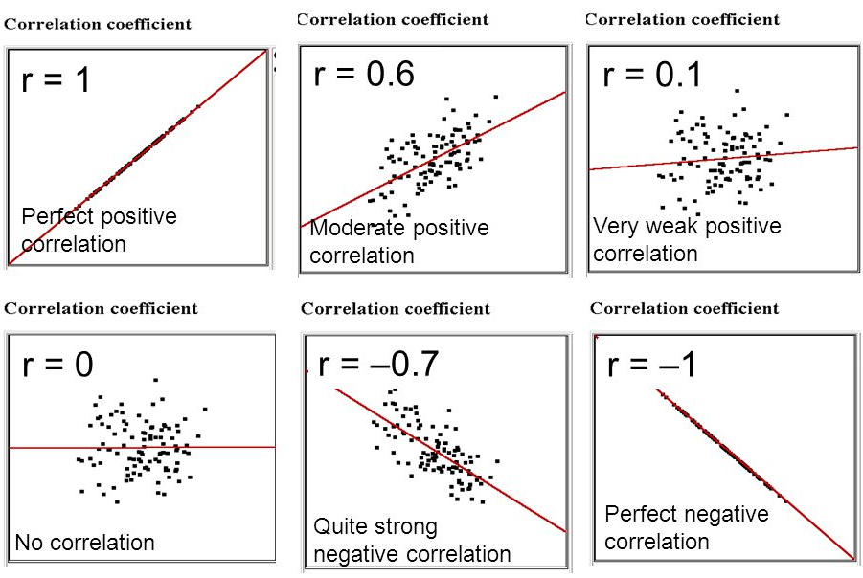
Strength of relationships
Notes:
Appreciation of Norwegian Black metal Band Dimmu Borgin against age

Slide 31
Assumptions Parametric Correlation
Pearson’s Correlation
Level of measurement
Interval or ratio
Exception:
You can have one independent variable with two categories (e.g. gender) and one continuous dependent.
Caveat: you must have approximately the same numbers of cases for each category of the categorical variable
Spearman’s Rho can be used for ordinal or ranked data

Slide 32
Assumptions Parametric Correlation
Related Pairs
Each case must provide a score on the two independent variables
Independence of observations
Each measurement must not be influenced by any other
E.g. if studying TV habits on children and all children are from same family then behaviours of one child are likely to affect all so observation is unlikely to be independent

Slide 33
Assumptions for Parametric Correlation
Normality
Scores should be normally distributed
Inspect histograms for each variable
Linearity
There must be a linear relationship between the two variables
Inspect a scatterplot and you should see a straight line not a curve
Homoscedasticity
Variability of variable 1 should be similar to variable 2
Check scatterplot
Looking at distance between the points to that straight line.
The shape of the scatterplot should be tube-like or rectangular in shape.
If the shape is cone-like, then homoscedasticity would not be met.
It is a matter of degree

Slide 34
Homoscedasticity
We are interested in the relationship between income levels and spending on gadgets.
We want to investigate if income level could be considered to predict the level of spending on gadgets.
We find a strong, positive association between income and spending.
So far so good.
But when we look at our pattern graphically we find the levels of spend are low for low incomes
This makes sense people with low incomes don’t spend lots of money on luxury items
And we find the level of spend varies for those with high incomes
Again this makes sense, some people are more moderate in their spending than others
We therefore have heteroscedasticity which means that it doesn’t make sense to base any prediction based on this relationship

Slide 35
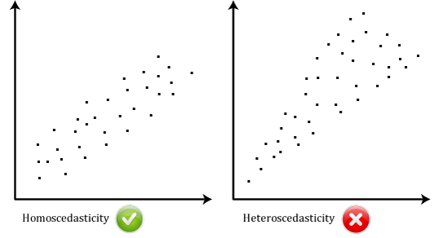
Homoscedasticity

Slide 36
Getting Started With Analysis
Inspect your data
Generate your descriptive statistics
Generate your visuals (graphs)
Make decisions about normality
Choose the correct tests

Slide 37
Example Pearson Correlation
For the dataset survey.sav (SPSS), survey.dat (R)
SPSS Survival Manual 6th Edition Julie Pallant
http://spss.allenandunwin.com.s3-website-ap-southeast-2.amazonaws.com/data-files.html#.Wb0vvnWP-po
Dataset created from a designed to explore the factors that impact on respondents’ psychological adjustment and wellbeing.
R dataset has been made available to you (survey.dat)
To load the data in R the command is (as usual change the location to reflect where you have the file saved
survey <- read.table("survey.dat”)
PSIWeek3-Lecture.rmd contains all the commands.

Slide 38
Example Pearson Correlation
Question:
“Is there a relationship between respondents’ feelings of control and their level of perceived stress?
Variables:
Feeing of control
tpcoiss
Total PCOISS derived from the PCOISS questionnaire (tpcoiss)
Dependent variable
Total Perceived Stress
tpstress
Derived from the perceived stress questionnaire
Independent variable

Slide 39
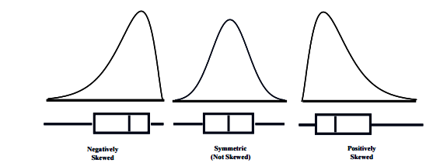
Plots and Histograms

Slide 40
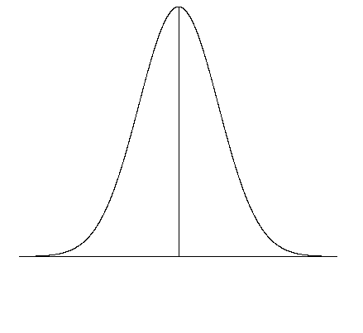
Normal Quantile Plot
Basically compares the spacing of our data to what we would expect to see in terms of spacing if our data were approximately normal.
If our data is approximately normally distributed we should spacing similar to what is shown on the normal curve on the right. Very few observations in both tails and increasingly more observations as we move towards the mean from either side. Also remember the spacing must be symmetric about the mean.

Slide 41
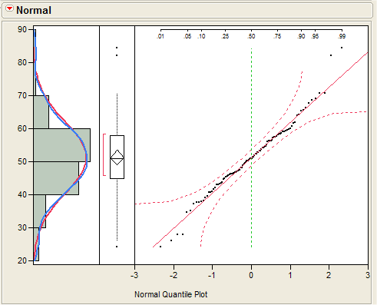
Normal Quantile Plot
THE IDEAL PLOT:
Here is an example where the data is perfectly normal. The plot on right is a normal quantile plot with the data on the vertical axis and the expected z-scores if our data was normal on the horizontal axis.
When our data is approximately normal the spacing of the two will agree resulting in a plot with observations lying on the reference line in the normal quantile plot. The points should lie within the dashed lines.

Slide 42
Normal Quantile Plot
THE IDEAL PLOT:
Here is an example where the data is perfectly normal. The plot on right is a normal quantile plot with the data on the vertical axis and the expected z-scores if our data was normal on the horizontal axis.
When our data is approximately normal the spacing of the two will agree resulting in a plot with observations lying on the reference line in the normal quantile plot. The points should lie within the dashed lines.

Slide 43
Detrended Q-Q Plot
In the Detrended Plot, the horizontal line at the origin represents the quantiles that we would expect to see if the data were normal;
The dots represent the magnitude and direction of deviation in the observed quantiles.
Each dot is calculated by subtracting the expected quantile from the observed quantile.
(This implies that if a dot is below the trend line on the Normal Q-Q plot, it will appear above the trend line on the Detrended Normal Q-Q plot, because observed - expected > 0.)

Slide 44
How do I inspect a scale variable?
Generate summary statistics
Make sure you include skewness and kurtosis
Generate a histogram with a normal curve showing
Generate a Q-Q plot
Review your statistics and plots to see how far away from normal your data is

Slide 45
How do I inspect a scale variable in R?
Use packages pastecs, ggplot2 and semTools
Install them using the install.packages e.g. install.packages(“pastecs”)
Thereafter tell R you want to use them e.g. library(pastecs)
Statistical summary
library(pastecs)
Use stat.desc function form
Will give you a set of summary statistics for a variable
stat.desc(varname, basic=F)
Make sure you include the basic switch=F to ensure you don't get scienfitic notation
Skewness and kurtosis with standard error Use package semTools
library(semTools)
skew(varname)
kurtosis(varname)
(we need the standard error to facilitate creating standardised score of skewness and kurtosis)

Slide 46
How do I inspect a scale variable in R?
Create a histogram
library(ggplot2)
g <- ggplot(survey, aes(x=varname))
#Change the label of the x axis
gg <- gg + labs(x=“The Label of the X Axis")
#manage binwidth and colours
gg <- gg + geom_histogram(binwidth=2, colour="black", aes(y=..density.., fill=..count..))
gg <- gg + scale_fill_gradient("Count", low="#DCDCDC", high="#7C7C7C")
qqnorm will create a qqplot
qqnorm(varname)
qqline(varname, col=2)
Qqline will show a line on the plot

Slide 47
Tests of Normality
As with all estimates we are unlikely to ever see the values of zero in either skewness or kurtosis statistics for the standardised scores of the variable of interest.
The real question is whether the given estimates vary significantly from zero.
We need to look at the standard error of skewness and kurtosis.
We are looking for is whether the value of ‘zero’ is within the 95% confidence interval.

Slide 48
Confidence Intervals
CI represents a range of values between which we think a population value will fall
Suppose we are looking at our fish in Lough Mask
True mean
15 thousand fish
Sample mean
17 thousand fish
Interval estimate
12 to 22 thousand(contains true value)
12 thousand < µ < 22 thousand
16 to 18 thousand (misses true value)
CIs constructed such that 95% contain the true value.
Confidence intervals for means are intervals constructed using a procedure that will contain the population mean a specified proportion of the time, typically either 95% or 99% of the time.

Slide 49
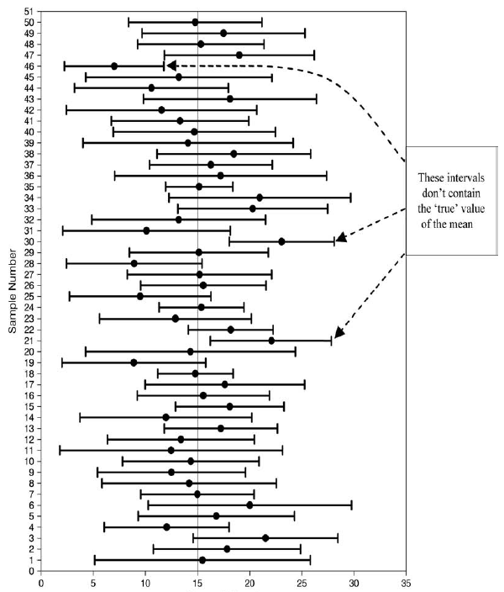
Fish Numbers(thousands)

Slide 50
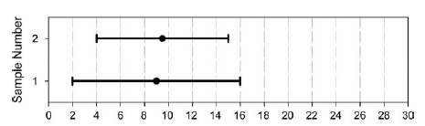
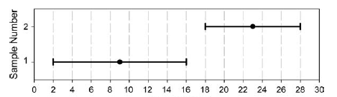
Fish Numbers(thousands)
Fish Numbers(thousands)

Slide 51
How to construct a CI?
Typically look at 95% CI but can also look at 99%
What does this mean?
If we say CI is 95% then if we collected 100 samples, calculated the mean
Then a CI of 95% means we are confident that 95 of these would contain the true mean
When you compute a confidence interval on the mean, you compute the mean of a sample in order to estimate the mean of the population.
Clearly, if you already knew the population mean, there would be no need for a confidence interval.

Slide 52
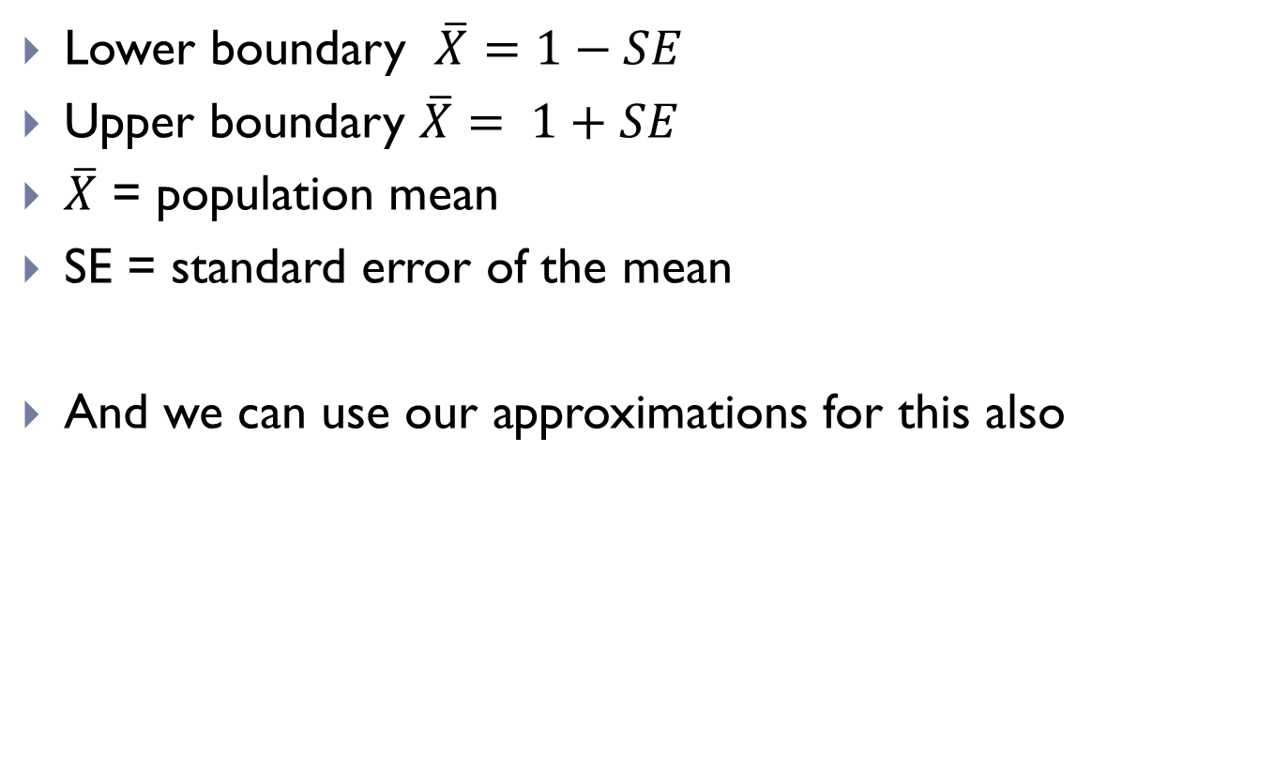
CI
Lower boundary $\overline{X}=1−SE$
Upper boundary $\overline{X}= 1+SE$
$\overline{X}$ = population mean
SE = standard error of the mean
And we can use our approximations for this also

Slide 53
CI
How to calculate?
Need to know the limits within which 95% of the means fall
Go back to the normal distribution – 95% of scores fall between +-1.96
Once we know the mean and standard deviation we can calculate any score and therefore the CI

Slide 54
Skewness and Kurtosis
Standardised scores for skewness and kurtosis between -2 and +2 are considered acceptable in order to prove normal univariate distribution.
George, D., & Mallery, M. (2010). SPSS for Windows Step by Step: A Simple Guide and Reference
Within R use library semTools
skew(survey$tpcoiss)
kurtosis(survey$tpcoiss)
Be careful when loading libraries, some have functions with the same names and later loads will override others

Slide 55
Tests of Normality
Standardised scores (value/std.error) for skewness between -2 and +2 are considered acceptable in order to prove normal univariate distribution.
George, D., & Mallery, M. (2010). SPSS for Windows Step by Step: A Simple Guide and Reference
Tpcois:
Standardised Skew = -.401/.118=-3.40 Standardised Kurtosis=.257/.236=1.08
Skewness is not acceptable so we need to look into this further.
Need to look at the outliers, how many of them there are or whether we can transform it to become more normal.

Slide 56
So our data has failed the standardised skew
Does this mean we can’t use parametric tests?
No
We can do some additional checks
First create a histogram to see how much skew there is

Slide 57
So our data fails the standardised skew
Convert the raw score for tpcoiss to a standardised score
If 95% of our data falls within +/- 1.96 then we can treat the data as normal
sort (scale(survey$tpcoiss))
will sort a list in ascending order

Slide 58
Deciding Normality
Check your Q-Q Plot
Check skewness and kurtosis standardised scores
Check impact of outliers
At 0.05 level if 95% of your data is within +/- 1.96 when converted to standardised scores – it is likely your data is safe to treat as normal
If the sample size is small (80 or fewer cases), a case is an outlier if its standard score is ±2.5 or beyond.
If the sample size is larger than 80 cases, a case is an outlier if its standard score is ±3.29 or beyond

Slide 59
So our data fails the standardised skew
For tpcoiss
23 values fall outside +/- 1.96 (including missing data)
23/439=5.2% of our data
10/439=2% of our data (if we exclude missing data)
Since the data is larger than 80 cases we can use +/- 3.29 as our measure
11/439=2.5% (including missing data)
2/439=0.04% (excluding missing data)
So it is ok to treat as normal

Slide 60
Example Pearson Correlation
Look at the distribution of both variables
Create a scatterplot
Look at outliers
Look at distribution of the data points
Run the correlation
Interpret the output
Check the information you have been given about the sample
Determine the direction of the relationship
Determine the strength of the relationship
Calculate the coefficient of determination
Assess the significance level

Slide 61
Conducting Correlation Analysis
Andy Field, Discovering Statistics

Slide 62
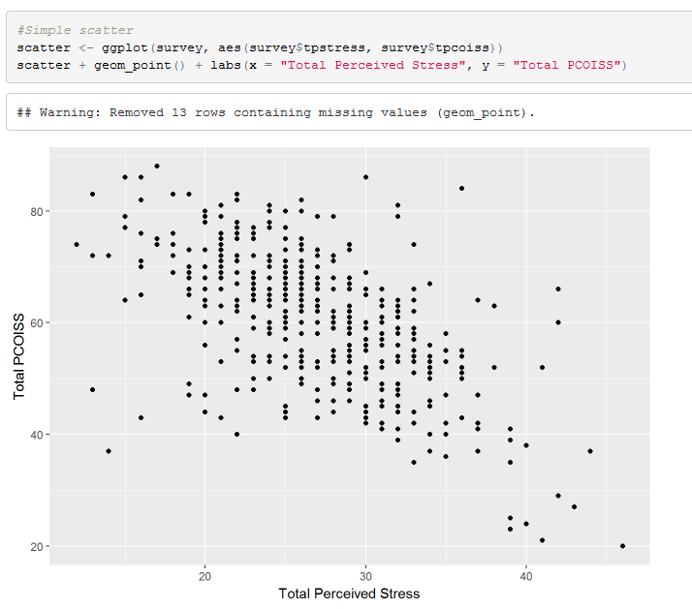
Total PCOISS and Total Perceived Stress

Slide 63
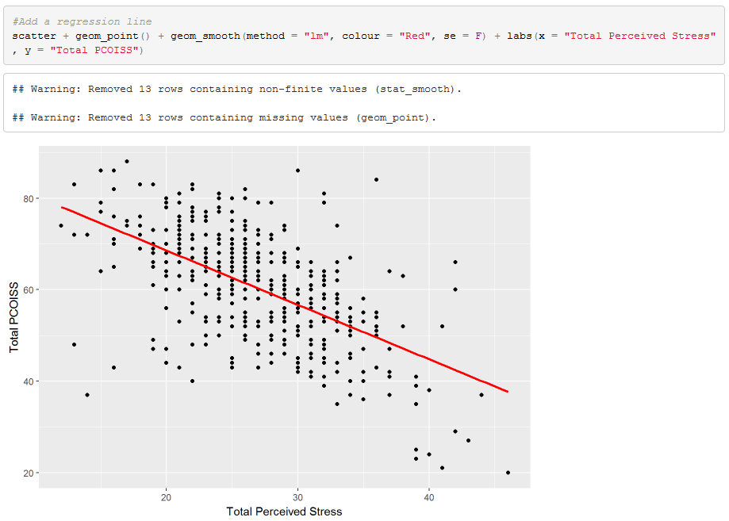
Total PCOISS and Total Perceived Stress

Slide 64
Total PCOISS and Total Perceived Stress
There appears to be negative correlation.
As stress increases, perceived control decreases

Slide 65
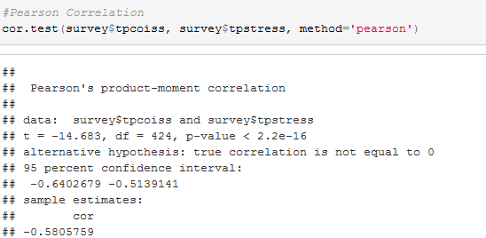
Doing an Correlation in R Total PCOISS, Total Perceived Stress
Pearson’s correlation co-efficient is the statistic
Call it r
Note 1: 2.2e-16 is 2.2 * e to the power of -16 (very small number)
Note 2: You should round your co-efficient to 2 or three decimal places e.g. -0.581

Slide 66
Things to know about the Correlation Co-efficient
It varies between -1 and +1
0 = no relationship
It is an effect size (ignore sign for magnitude of effect)
±.1 = small/weak
±.3 = medium/moderate
±.5 = large/strong
Cohen’s effect size heuristic is standard
Find a book that is respected in your field that discusses this and cite it when stating you used Cohen’s convention
Key Slide

Slide 67
r²
Coefficient of determination, r²
By squaring the value of r you get the proportion of variance in one variable shared by the other.
You can report this if it is relevant to your domain.
In some cases you may report a set of coefficients in a table and discuss the variance in the text.
For our example r² for -.580*-.580=.3364
This means that time Total PCOISS and Total Perceived stress share 33.64% of their variance
Always round up to 2 decimal places
Shared variance

Slide 68
Reporting a Pearson Correlation in words
“The relationship between Total PCOISS (derived from the PCOISS questionnaire) and Total Perceived Stress (derived from the perceived stress questionnaire) was investigated using a Pearson correlation. A strong negative correlation was found (r =-.580, n=424, p<.001).”
NOTE1:
Because the significance is .000 in test results, the convention is to report it as <.001
NOTE2:
N=424 because it does not include missing values

Slide 69
Covariance
Variance tells us by how much scores deviate from the mean for a single variable.
Covariance = Scaled version of variance
Calculate the error between the mean and each observations score for the first variable (x).
Calculate the error between the mean and their score for the second variable (y).
Multiply these error values.
Add these values and you get the cross product deviations.
The covariance is the average cross-product deviations

Slide 70
Covariance
It depends upon the units of measurement.
E.g. The Covariance of two variables measured in Miles might be 4.25, but if the same scores are converted to Km, the Covariance is 11.
One solution: standardise it!
Divide by the standard deviations of both variables.
Create standardised scores
Analyse -> Descriptive Statistics -> Frequencies (check Save as Standardised Scores)
The standardised version of Covariance is known as the Correlation coefficient.

Slide 71
What is a test of hypotheses?
Is it one of the values of the sample statistic that are likely to occur?
A test of hypotheses is a method that uses sample data to decide between two competing claims (hypotheses) about the population characteristic.
Is the value of the sample statistic . . .
a random occurrence due to natural variation?
OR
Is it one that isn’t likely to occur?
a value that would be considered surprising?

Slide 72
Hypothesis Testing
Goal : Make statement(s) regarding unknown population parameter values based on sample data
Elements of a hypothesis test:
Null hypothesis (H₀)
Statement regarding the value(s) of unknown parameter(s).
Typically will imply no association between independent and dependent variables in our theory (will always contain an equality)
Alternative hypothesis (H_{a})
Statement contradictory to the null hypothesis (will always contain an inequality)
Collect data and seek evidence against H₀ as a way of bolstering H_{a} (deduction
Test statistic
Quantity based on sample data and null hypothesis which allows you to determine between null and alternative hypotheses

Slide 73
Hypothesis Testing
Hypothesis may concern an effect (e.g. correlation) in the population or a difference between groups in a population.
The general goal of a hypothesis test is to rule out chance (sampling error) as a plausible explanation for the results from a research study.
All hypothesis testing starts with the null hypothesis : that there is no effect or difference in the population.

Slide 74
Hypothesis statements:
The null hypothesis, denoted by H₀, is a claim about a population characteristic that is initially assumed to be true.
The alternative hypothesis, denoted by H_{a}, is the competing claim.
You are usually trying to determine if this claim is believable.
The hypothesis statements are ALWAYS about the population
– NEVER about a sample!
To determine what the alternative hypothesis should be, you need to keep the research objectives in mind.

Slide 75
The Form of Hypotheses:
Null hypothesis
H₀: population characteristic = hypothesized value
Alternative hypothesis
H_{a}: population characteristic > hypothesized value
H_{a}: population characteristic < hypothesized value
H_{a}: population characteristic ≠ hypothesized value
This one is considered a two-tailed test because you are interested in both direction.
The null hypothesis always includes the equal case.
This hypothesized value is a specific number determined by the context of the problem
This sign is determined by the context of the problem.
Notice that the alternative hypothesis uses the same population characteristic and the same hypothesized value as the null hypothesis.
These are considered one-tailed tests because you are only interested in one direction.

Slide 76
Our example
H0: There is no relationship between Total PCOISS and Total Perceived Stress
Ha: There is a relationship between Total PCOISS and Total Perceived Stress
Two-tailed hypothesis

Slide 77
When you perform a hypothesis test you make a decision:
reject H₀ or fail to reject H₀
When you make one of these decisions, there is a possibility that you could be wrong!
That you made an error!
Each could possibly be a wrong decision; therefore, there are two types of errors.

Slide 78
Type I error
The error of rejecting H₀ when H₀ is true
The probability of a Type I error is denoted by α.
α is called the significance level of the test
Key Slide
This is the lower-case Greek letter “alpha”.

Slide 79
Type II error
The error of failing to reject H₀ when H₀ is false
The probability of a Type II error is denoted by β
Key Slide
This is the lower-case Greek letter “beta”.

Slide 80
Here is another way to look at the types of errors:
Suppose H₀ is true and we fail to reject it, what type of decision was made?
Suppose H₀ is false and we reject it, what type of decision was made?
Suppose H₀ is true and we reject it, what type of decision was made?
Suppose H₀ is false and we fail to reject it, what type of decision was made?
 | H₀ is true | H₀ is false
Reject H₀
Fail to reject H₀
Type I error
Correct
Type II error
Correct

Slide 81
P-value, α – statistical significance
Key Slide
A probability measure of evidence about H_{0.}
Put simply it is the probability, given the null hypothesis is true, that the results could have been obtained purely on the basis of chance alone.
The probability (under presumption that H₀ true) the test statistic equals observed value or value even more extreme predicted by H_{a}
The P-value allows us to answer the question:
Do our sample results allow us to reject H₀ in favour of H_{a}?
If that probability (p-value) is small, it suggests the observed result cannot be easily explained by chance

Slide 82
Statistical Significance
Key Slide
Working with random samples can never have 100% certainty that findings we derive from the sample will reflect real differences in the population as a whole.
Convention is that (for your field of study) there is an accepted level of probability such that it is considered so small that the finding from your sample is unlikely to have occurred by chance or sampling error.
Normally, that line is drawn at p=0.05 or p=0.01.
In other words, when a statistical test tells us that the finding has less than a 5% or 1% chance of occurring due to sampling error then we tend to conclude that we can be sufficiently confident that the finding is therefore likely to reflect a ‘real’ characteristic of the population as a whole.
When this occurs, you can say that your finding is statistically significant.

Slide 83
Statistical Significance
A range of statistical tests can be used
Each will tell you how likely it is that a finding you get from your sample would occur simply by chance if no such difference actually existed in the population as a whole
ie. the probability that your finding is simply a fluke occurrence deriving from the random selection of your sample.

Slide 84
One-tailed and Two-tailed Tests
P values are calculated for you are based upon a non-directional alternative hypothesis
Two-tailed tests
In other words
While you state that a difference may exist between men and women, you don’t state what that difference is i.e. is it likely to be more men than women or more women than men?

Slide 85
One-tailed and Two-tailed Tests
If you can be more specific prior to analysing your data, usually on the basis of a theory you may have, and thus state a directional hypothesis then you can cut the probability calculated for you in half.
This is called a one-tailed test.
Thus if your statistical test gives you a value of p=0.07 then, if you have stated a directional hypothesis and your findings confirm this, then you can quote the probability as p=0.035
(which then may become statistically significant depending on the level you are working with).

Slide 86
Hypothesis Testing
You start with the assumption (the 'null hypothesis' H₀) that there are no differences or relationships in the population as a whole.
You then state an alternative hypothesis (H_{A}) that there is a difference or a relationship.
You select a sample and find a difference/relationship in it.
You can then use a variety of tests for statistical significance to work out the probability of the difference/relationship you have found in your sample simply occurring by chance.

Slide 87
Hypothesis Testing
Using the standard level accepted by your domain (e.g. p ≤0.05 or p ≤0.01)
If the probability less than this value then you reject the null hypothesis and thus accept the alternative hypothesis and you can state that your findings are 'statistically significant'.
If the probability is greater this value then you conclude that there is no evidence to reject the null hypothesis and your findings are not ‘statistically significant’.
N.B This is different from concluding that you have evidence to accept the null hypothesis. In these cases, your findings are said to be ‘not significant’.
Caveat
If we get a p-value of 0.051 should we accept the null hypothesis?
Should we reject the null hypothesis if we get a p-value of 0.049?
Need to allow for some flexibility in interpretation

Slide 88
Accepting and Rejecting Hypotheses
A non-statistically significant test result does not mean that the null hypothesis is true
A significant result does not mean that the null hypothesis is false
Key Slide

Slide 89
Our Example -Doing a Correlation
This significance value tells us that the probability of this correlation being due to random chance is very low (close to zero in fact).
Hence, we can have confidence that this relationship is genuine and not a chance result.

Slide 90
P-value
If no decision needed, report and interpret P-value
If decision needed, select a cutoff point (such as 0.05 or 0.01) and reject H0 if P-value ≤ that value

Slide 91
Reporting the results
If you wish to report in text
“The relationship between Total PCOISS (derived from the PCOISS questionnaire) and Total Perceived Stress (derived from the perceived stress questionnaire) was investigated using a Pearson correlation. A strong negative correlation was found (r =-.58, n=424, p<.001).”
Key Slide
NOTE1:
Because the significance is .000 in test results, the convention is to report it as <.001
NOTE2:
N=424 because it does not include missing values

Slide 92
Things to know about the Correlation Co-efficient
It varies between -1 and +1
0 = no relationship
It is an effect size (ignore sign for magnitude of effect)
±.1 = small/weak
±.3 = medium/moderate
±.5 = large/strong
Cohen’s effect size heuristic is standard

Slide 93
Things to know about the Correlation Co-efficient
Coefficient of determination, r²
By squaring the value of r you get the proportion of variance in one variable shared by the other.
You can report this if it is relevant to your research.
In some cases you may report a set of coefficients in a table and discuss the variance in the text.
What does this mean?
In our example r= r =-.58 so r²=0.3364=33.64%
What does this mean?
Our concepts have 33.64% of their variation in common

Slide 94
Things to know about the Correlation Co-efficient
Significance of all co-efficient and covariance depends on the p-value (significance value of the test)

Slide 95
Correlation and Causality
The third-variable problem:
Causality between two variables cannot be assumed because there may be other measured or unmeasured variables affecting the results.
In our example
Perceived stress does relate significantly to perception of control
There may be other factors that are influencing perception of control.
And some of these variables may not have been measured by the researcher.

Slide 96
Correlation and Causality
Direction of causality:
Correlation coefficients say nothing about which variable causes the other to change.
The correlation coefficient doesn’t indicate in which direction causality operates.
So, although it is intuitively appealing to conclude that perceived stress causes perceived control to change, there is no statistical reason why perceived control cannot cause perceived stress.
This is where your knowledge of the constructs and existing theories in your area come in to play
You interpret your statistical findings through the lens of your subject area
Why including relevant background and related research is important in your reporting

Slide 97
Statistical v Practical Significance
A small correlation co-efficient can reach statistical significance.
This doesn’t mean anything practically.
Need to consider both the co-efficient and the amount of shared variance (squaring the co-efficient) .
E.g. a coefficient of 0.2 explains 4% of the shared variance
Need also to consider other research into the area and compare your findings with those
Even though your research explains only a small amount of the variance it may be more than others have found (or less).

Slide 98
Sample size and correlation
In small samples (e.g. n=30) you may have moderate correlation that does not reach statistical significance
In larger samples (n=100+) small correlations may reach statistical significance
You need to report statistical significance but also the strength of the relationship and the amount of shared variance.

Slide 99
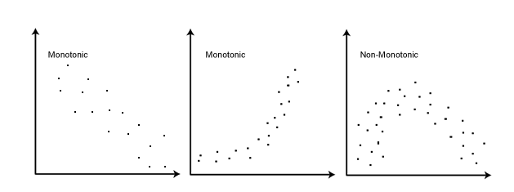
Spearman (Non-parametric)
Doesn’t require normality
Requires independent observations
Use when assumptions of Pearson are violated or when data is not scale
Spearman - Requires a monontonic relationship – as one variable increases, so does the other or as one increases the other decreases

Slide 100
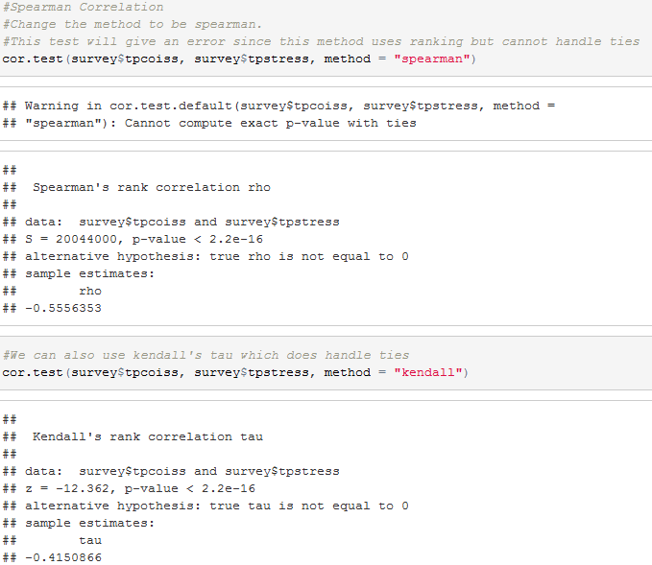
Spearman Correlation in R
Spearman’s Rho is the statistic
Kendall’s Tau is the statistic

Slide 101
Reporting Spearman and Kendall in words
As you would for Pearson except make sure you cite the correct test and give the correct statistic
Spearman
Spearman’s rho
or r_{s}
or the Greek letter ρ
Kendall
Kendall’s tau
Kendall's tau-b
τ_{b}

Slide 102


Comparison between Samples
Sometimes we want to investigate if an effect is different for different groups within our population
There are a range of statistical tests we can use. The choice depends on:
The measurement of the variable
The shape of the data
Are these groups different?
Notes:
Usually, you only have access to samples which means you never capture a population as a whole
Need to be careful that your samples is representative of your population

Slide 103



Tests for Group Comparison
 | Independent Samples | Related Samples also called dependent means test
Interval measures/ parametric | Independent samples t-test* | Paired samples t-test**
Ordinal/ non-parametric | Mann-Whitney U-Test | Wilcoxon test
* 2 different groups of participants
** 2 same participants measured at two different points
Notes:
There are lots of different types of t-tests, which need to be used depending on the type of data you have
(equal) interval measures
Scales in which the difference between consecutive measuring points on the scale is of equal value throughout
No arbitrary zero, ie positive and negative measures, eg temperature
Ordinal measures
Scales on which the items can be ranked in order
There is an order of magnitude but intervals may vary, ie one item on the scale is more or less than another but it is not clear by how much as this cannot be measured
Often statements/ feelings are attached to numbers which can then be used for rating; in fact, this data can only be ranked (from highest to lowest) , ie what score had the highest turn-out
1= very good, 2= good, 3= neutral, 4= bad, 5= very bad
Different measurements have a direct influence on the way analysis is conducted because some of them are more amenable to mathematical operations than others

Slide 104

Parametric: t-tests
comp
infer
12
10
95% CI
8
6
Left hemisphere
right hemisphere
Exp. 1 Exp. 2
lesion site
Compare the mean between 2 samples/groups/conditions
If 2 samples are taken from the same population, then they should have fairly similar means
⇨ if 2 means are statistically different, then the samples are likely to be drawn from 2 different populations, i.e. they really are different

Slide 105
t Distribution
Very similar to the Z distribution by assuming normality.
Normality is obtained after about 120 data observations.
In which case t = z
Basic rule of parameter estimation:
The higher the observations (N) of sample the more reflective of overall population.

Slide 106
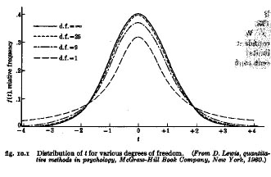
The t Distribution
The t distribution is a short, fat relative of the normal.
The shape of t depends on its degrees of freedom.
As N becomes infinitely large, t becomes normal and becomes z

Slide 107
t distribution critical values table
Only need to check if your sample is smaller than 120
https://www.easycalculation.com/statistics/t-distribution-critical-value-table.php
Your statistical tool will do this look up for you and calculate whether your test is statistically significant or not.

Slide 108


Comparison between Conditions
Is the activation (from MRI) different when you compare 2 different conditions?
Reading aloud (script) vs “Reading” finger spelling (sign)
Reading aloud vs Picture naming
Notes:
Is the activation different when you compare 2 different conditions?
Exp. 1: reading script is compared to “Reading” finger spelling (sign)
or
Exp. 2: when picture naming is compared to reading aloud those exact object labels (eg, naming the picture of a tiger versus reading the word “tiger”)?

Slide 109

t-test
Exp. 1
Reading script (blue) is compared to “Reading” finger spelling (green)
Activation patterns are similar, not significantly different
=> they are similar tasks
Exp. 1 Exp. 2
Notes:
or

Slide 110
t-test
Exp. 2
When picture naming (green) is compared to reading aloud (blue) those exact object labels (e.g. naming the picture of a tiger versus reading the word “tiger”)
reading causes significantly stronger activation and this is different to naming
Activation patterns are very (and significantly) different
=>reading aloud different to naming
Exp. 1 Exp. 2
Notes:
or

Slide 111
Formula for test statistic
Difference between the means divided by the pooled standard error of the mean
SE variability between sample means - if large then may be a problem with representativeness of the sample
Reporting convention: t= 11.456, df= 9, p< 0.001
(Remember df depends on the number in your sample)
Notes:
t-value+ an end product of a calculation
df = degrees of freedom (the number of individual scores that can vary without changing the sample mean)
Standard error
Is the standard deviation of sample means
It is a measure of how representative a sample is likely to be of the population
Large SE (relative to the sample mean): lots of variability between means of different samples ⇨ used sample may not be representative of a population
Small SE: most sample means are similar to the population mean ⇨ sample is likely to be an accurate reflection of the population

Slide 112
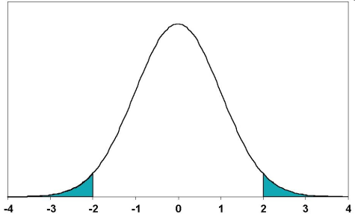


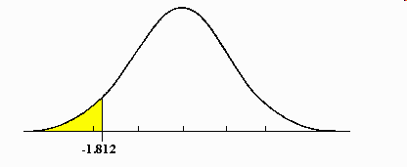
Types of t-tests cont.
2-tailed tests vs one-tailed tests
2 sample t-tests vs 1 sample t-tests
2.5%
2.5%
Mean
Mean
A known value
Mean
5%
Notes:
2-tailed tests vs one-tailed tests
If you set alpha-level at 0.05, there is 5% “area” in which a score would fall (outside where it is expected)
2-tailed tests leave room for this area to occur on both extreme ends, ie improvement may be either positive or negative (ie, 2,5% at either end)
One-tailed tests deny this and assume that the 5% can only occur at one extreme end (5%)
Both tails are meaningful in behavioural studies and should be favoured
2 sample t-tests vs 1 sample t-tests
2 sample t-tests compare the mean of 2 samples (both means are measured within the experiment)
1 sample t-tests compare the mean of one sample to a known value, often a (previously known) population mean
In fMRI: compare either 2 activation means of 2 different groups to each other or see if your one sample reaches a level of activation that you are expecting given some prior knowledge

Slide 113
Assumptions
The t-test is based on assumptions of normality and homogeneity of variance.
You can test for both these
As long as the samples in each group are large and nearly equal, the t-test is robust, that is, still good, even though assumptions are not met.

Slide 114
Assumptions of the t-test
Both the independent t-test and the dependent t-test are parametric tests based on the normal distribution.
Therefore, they assume:
Data are measured at least at the interval level.
The sampling distribution is normally distributed.
In the dependent t­-test this means that the sampling distribution of the differences between scores should be normal, not the scores themselves.
The independent t-test, because it is used to test different groups of people, also assumes:
Variances in these populations are roughly equal (homogeneity of variance).
Scores in different treatment conditions are independent (because they come from different people).

Slide 115
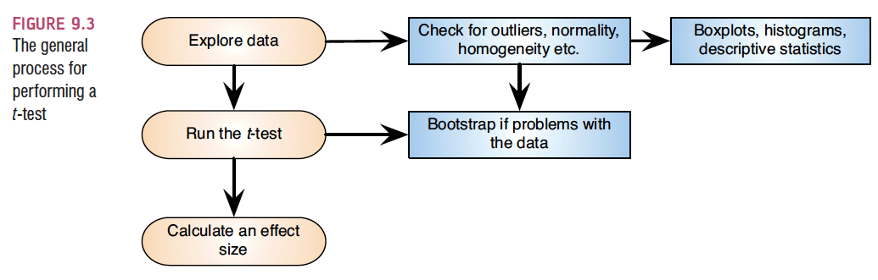
Independent t-test using SPSS

Slide 116
Independent t-test Example
Survey.dat (Julie Pallant)
Dataset created from a designed to explore the factors that impact on respondents’ psychological adjustment and wellbeing.
Question:
Is there a significant difference in the mean self-esteem scores for males and females?
Need
One categorical variable (male/female gender)
One continuous, dependent variable (self-esteem score tslfest)
T-test
Will tell you whether there is a statistically significant difference between the mean scores of the groups

Slide 117
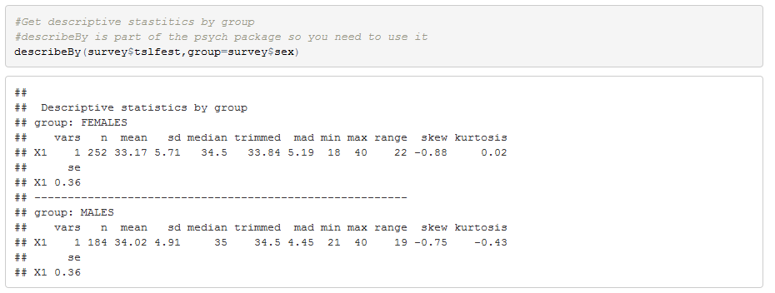
Independent t-test in R
We need to look at the descriptive statistics for the variable by group

Slide 118
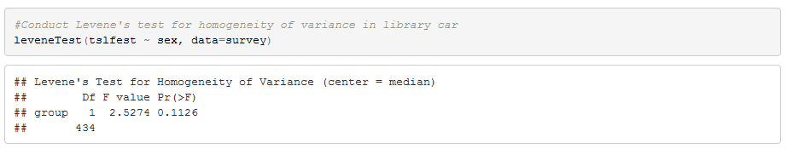
Independent t-test in R
We need to know the homogeneity of variance in advance so we can set the parameter on the t-test so we conduct the Levene’s test first

Slide 119
Testing for Homogeneity of Variance
In SPSS the relevant test for homogeneity of variance will be included in the output for the test you are conducting (e.g Levene’s test for t-test, Bartlett’s test for other tests)
In R you need to choose and test in advance of running other tests
Levene’s test is best – this is the most robust test for normally distributed data. Null hypothesis is that the variance is equal.
Fligner-Killeen test - this is a non-parametric test equivalent.
To run in R
Levene’s is in the library car
library(car)
leveneTest(continuousvariable ~ categoricalvariable, data=dataframename)
E.g. levelTest(tslfest~sex,data=sdata)
Gives as output an F statistic and an estimate of significance

Slide 120
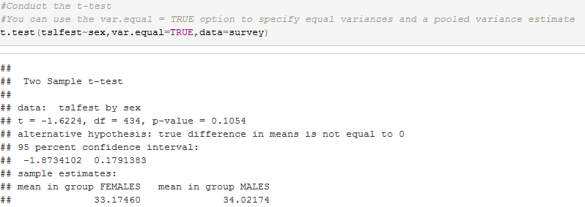
Independent t-test in R
Conduct the t-test: t.test( ) function produces a variety of t-tests.
t.test(y~x) # where y is numeric and x is a binary factor
Unlike most statistical packages, the default assumes unequal variance and applies the Welsh df modification.
You can use the var.equal = TRUE option to specify equal variances and a pooled variance estimate.

Slide 121
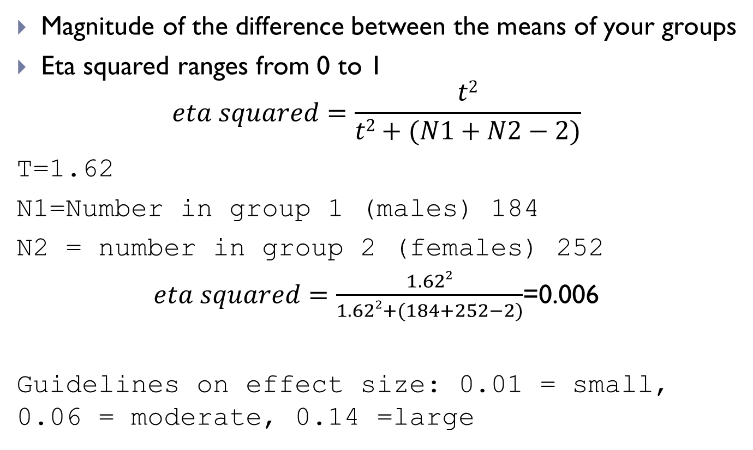
Calculating effect size
Magnitude of the difference between the means of your groups
Eta squared ranges from 0 to 1
$$eta squared=\frac{t2}{t2+(N1+N2−2)}$$
T=1.62
N1=Number in group 1 (males) 184
N2 = number in group 2 (females) 252
$eta squared=\frac{1.622}{1.622+(184+252−2)}$=0.006
Guidelines on effect size: 0.01 = small, 0.06 = moderate, 0.14 =large

Slide 122
Calculating effect size
Cohen’s d
Value for a between subjects t test and the degrees of freedom.
Cohen's d = 2t /√(df)
In this case d= 0.155
Reporting Cohen’s d
0.2=small effect, 0.5=moderate, 0.8 = large
NOTE: Choice of using eta squared or Cohen’s d depends on your field of study

Slide 123
Assumptions for Non-Parametric Tests
Random samples
Independent observations
Each case is counted only once
Unless it is a repeated measure where the same participants are retested on different occasions or under different conditions

Slide 124
Non-Parametric Example from Andy Field
Our neurologist investigating the depressant effects of certain alcoholic drinks:
Tested 20 clubbers
10 were allowed to drink only vodka on a Saturday night
10 were allowed to drink only beer.
Levels of depression were measured using the Beck Depression Inventory (BDI) the day after and midweek.
We are hypothesising that two groups of different entities will differ on the result of a test for depression.
A similar number of high and low ranks in each group would suggest depression levels do not differ between the groups.
A greater number of high ranks in the vodka group than the beer group would suggest the vodka group is more depressed than the beer group.
Field-BDI-NonParametric.dat

Slide 125
Non-Parametric: Comparing two independent conditions
This requires us to fit a model that compares the distribution of this variable for those in the beer group and the vodka group.
Requires us to test differences between two conditions in which different participants have been used.
To compare the distribution of two conditions and these conditions then you can use:
The Mann-Whitney test and
Wilcoxon’s Rank-sum test
These work on ranking data.

Slide 126
Ranking Data
The tests work on the principle of ranking the data for each group:
Lowest score = a rank of 1,
Next highest score = a rank of 2, and so on.
Tied ranks are given the same rank: the average of the potential ranks.
For an unequal group size the test statistic (Ws) = sum of ranks in the group that contains the least people.
For an equal group size the test statistic Ws = the value of the smaller summed rank.
Add up the ranks for the two groups and take the lowest of these sums to be our test statistic.
The analysis is carried out on the ranks rather than the actual data.

Slide 127
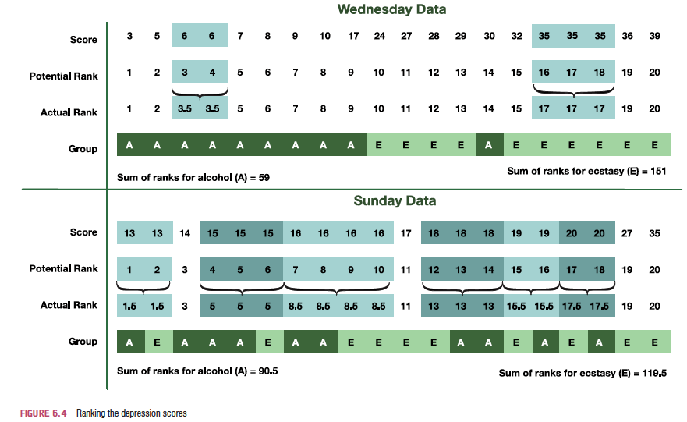
Ranking the Depression scores for Wednesday and Sunday
Sum of ranks for Vodka=59
Sum of ranks for Beer=151
Sum of ranks for Vodka=90.5
Sum of ranks for Beer=119.5

Slide 128
Provisional analysis using IBM SPSS
First, run some exploratory analyses on the data
Run these exploratory analyses for each group because we’re going to be looking for group differences.
Using Menus
Analyze -> Descriptive Statistics -> Explore ;
Put BDI Sunday in dependent box, Drink in factor box;
Click Plots and make sure normality plots with tests is checked.
In Syntax
Using the Examine command
EXAMINE VARIABLES=BDISun BY Drink
/PLOT BOXPLOT STEMLEAF
/COMPARE GROUPS
/STATISTICS DESCRIPTIVES
/CINTERVAL 95
/MISSING LISTWISE
/NOTOTAL.

Slide 129
Provisional analysis using R
Load the data
drinkset<- read.table("C:/tempR/Field-BDI-Non-parametric.dat")
Get your descriptive statistics
describeBy(drinkset$bdisun,group=drinkset$drink)
Create your plots using ggplot

Slide 130
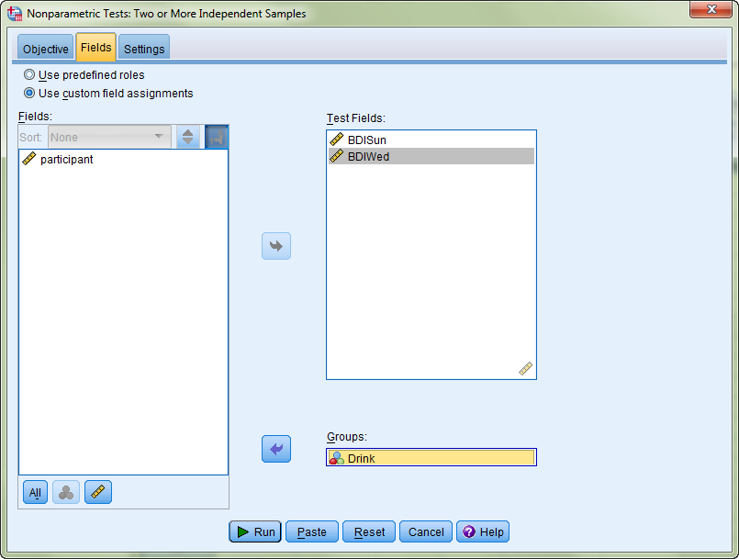
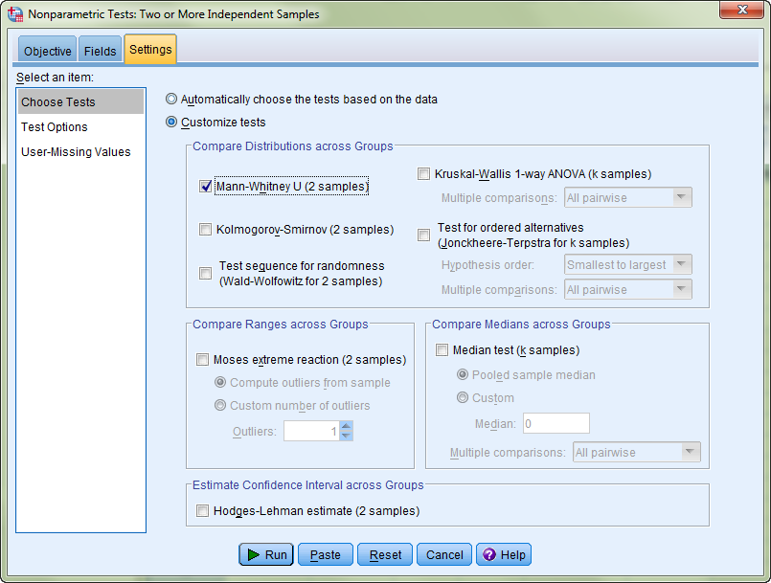
Mann-Whitney Test
SPSS Menus: Analyse -> Non-Parametric Tests ->Independent Samples
Click Customise Analysis

Slide 131
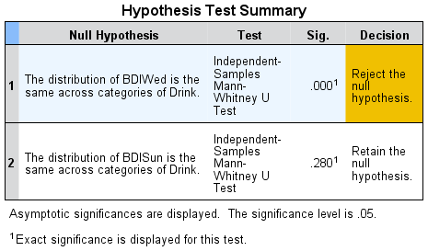
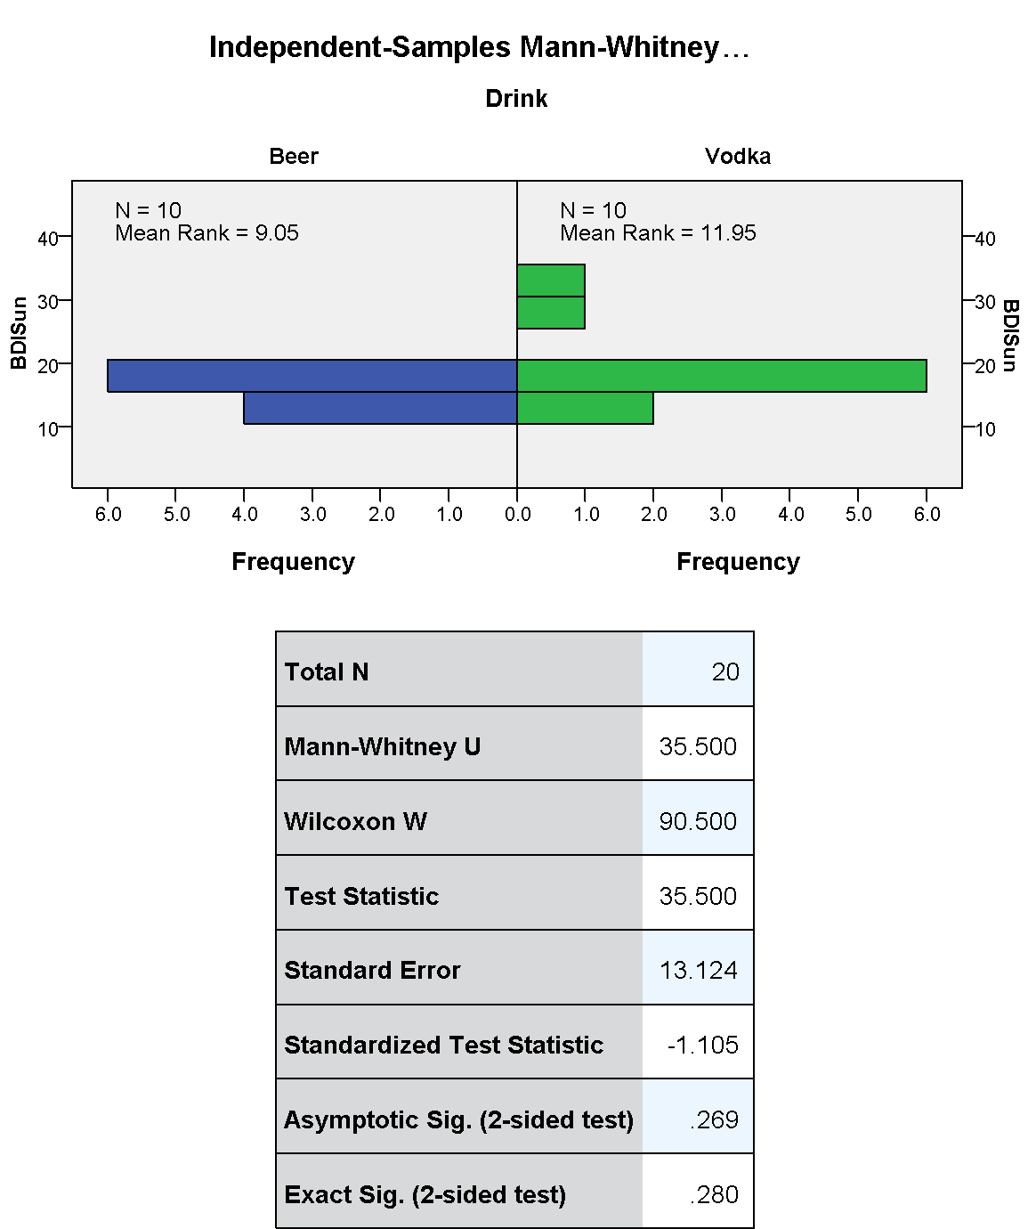
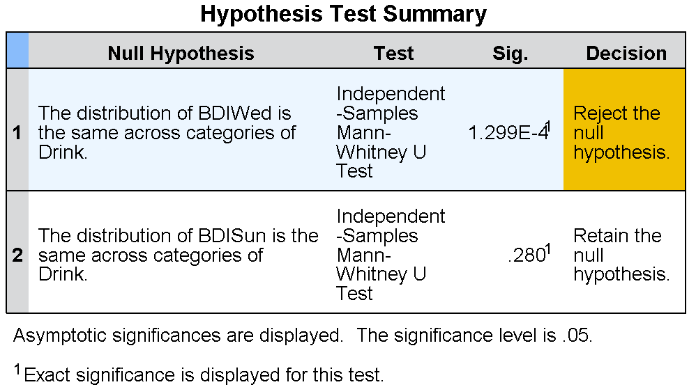
Double-click Summary to get into Detailed Analysis
Double-click each row to view the details of the analysis – shown in the right-hand pane

Slide 132
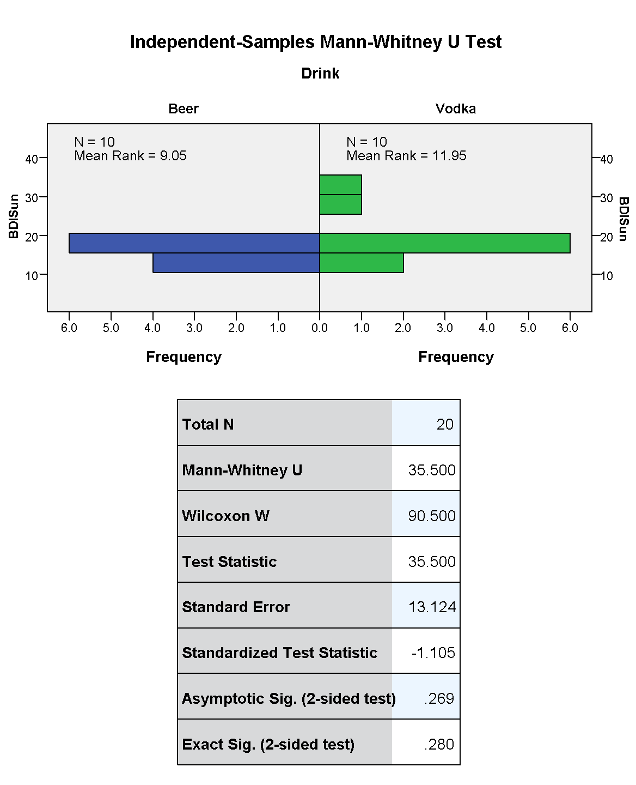
This is Z

Slide 133
Mann-Whitney test
It is used to test the null hypothesis that two samples come from the same population (i.e. have the same median) or, alternatively, whether observations in one sample tend to be larger than observations in the other.
Compares the medians from two populations and works when the Y variable is continuous and the X variable is discrete with two attributes.
Of course, the Mann-Whitney test can also be used for normally distributed data, but in that case it is less powerful than the 2-sample t-test.

Slide 134
The U Value
The U value for each group is calculated by subtracting the possible minimum rank which the group can take from the sum of the ranks, and the smallest U value is used for the test.
For the test of significance of the Mann-Whitney U-test it is assumed that with n > 80 or each of the two samples at least > 30 the distribution of the U-value from the sample approximates normal distribution.
U value is compared to table of critical values depending on the size of each sample
U value must be equal to or less than critical value

Slide 135


Calculating an Effect Size
The equation to convert a z-score into the effect size estimate, r, is as follows (from Rosenthal, 1991: 19):
z is the z-score that SPSS produces
N is the size of the study (i.e. the number of total observations)
We had 10 vodka users and 10 beer users and so the total number of observations was 20.
Rounded value of Z
Rosenthal 1991 Meta-analytic procedures for social research, SAGE

Slide 136
Reporting the Results
For the Mann–Whitney test:
Depression levels in vodka users (Mdn = 17.50) did not differ significantly from beer users (Mdn = 16.00) the day after the drugs were taken, (U = 35.50, z = −1.11, p = .280, r = −.25). However, by Wednesday, vodka users (Mdn = 33.50) were significantly more depressed than beer users (Mdn = 7.50), (U = 4.00, z = −3.48, p < .001, r = −.78).
NOTE
We report the median values because the data is not normally distributed.

Slide 137
In R – Mann Whitney U
wilcox.test(y~A)#where y is your continuous variable and A is your categorical
drinkset<- read.table('Field-BDI-Non-parametric.dat')
wilcox.test(bdisun~drink, data=drinkset) Warning in wilcox.test.default(x = c(16L, 15L, 20L, 15L, 16L, 13L, 14L, : cannot compute exact p-value with ties
Wilcoxon rank sum test with continuity correction data: bdisun by drink
W = 35.5, p-value = 0.2861 alternative hypothesis: true location shift is not equal to 0
wilcox.test(bdiwed~drink, data=drinkset)
Warning in wilcox.test.default(x = c(5L, 6L, 30L, 8L, 9L, 7L, 6L, 17L, 3L, : cannot compute exact p-value with ties Wilcoxon rank sum test with continuity correction data: bdiwed by drink
W = 4, p-value = 0.000569 alternative hypothesis: true location shift is not equal to 0

Slide 138
Relationships and Causality
How to determine if a relationship is causal?
Identify the directionality of relationships between independent (also called predictor variable) and dependent variables (also called outcome variable)
Independent Variable hypothesised to cause changes in Dependent Variables

Slide 139
Relationships and Causality
Examples:
Independent Variable | Dependent Variable
Death Penalty | Crime Rate
School Funding | Graduation Rate
Graduation Rate | Crime Rate
Parental Income | Graduation Rate
Parental Educational Level | Graduation Rate
Revision time | Exam Result

Slide 140
Causal Relationship
To assert a causal relationship is to claim that changes in the independent variable create changes in the dependent variable
In practice can only assert that one factor causes change in another when you can satisfy the following criteria:
Association
There must be a relationship between the two variables
Time order
The change in the independent variable precedes the change in the dependent
Non-spuriousness
The effects of a third unmeasured ‘spurious’ factor does not produce the relationship between the two variables

Slide 141
Causal Relationship - Association
Variables correspond to each other in predictable ways
Can be either positive (an increase in one causes an increase in the other)
Or negative (an increase in one causes a decrease in the other)
Many associations are not causal
E.g.
Red cars do not cause more accidents
Rather aggressive drivers are more likely to buy red cars
Aggressive drivers are more likely to be involved in accidents

Slide 142
Causal Relationship – Time Order
Logically when a change in one variable causes a change in another, the change in the independent needs to occur before the change in the dependent
Need to be careful
Even if time order is satisfied, a causal relationship may not exist

Slide 143
Causal Relationship – Non-spuriousness
A spurious relationship exists when two variables appear to be causally related but their relationship can be attributed to a third unidentified variable
E.g.
Ice cream consumption causing drowning deaths
There is an association between ice cream consumption and drowning (more people die during times when a lot of ice cream is being consumed)
Time order can also be satisfied – increase in ice cream sales precede increase in drowning deaths
However, the unmeasured factor here is seasonal temperature
In warm weather more people consume ice cream and swim

Slide 144
Relationships and Causality
Causality
Determining how particular sets of conditions (represented by variables) lead to particular outcomes (also represented by variables)
Seldom are relationships deterministic
Everyone completing a university degree will have a higher income than those who do not (unlikely to be true)
Most are probabilistic
i.e. factors increase or decrease tendency towards particular outcomes
Those with a university degree tend to earn more than those who do not
University education is a factor that pushes another factor (income) in a predictable direction

